Slide 1
Welcome to EVRN 460!
Phenology Tease
Class Details
Phenology
Yes, lab happens this week! Prepare to be outside for the full time.
Intro to you due before your lab
Feinsinger reading and assignment due before your lab
Real assignment before lab next week (Monday is Labor Day so we are not meeting)
What do my watery eyes have to do with climate change?
Do I need a book for this class?
Are invasive plants really that bad?
Will I need to memorize lots of scientific names?
Will we have lab if it is hot/cold/rainy/windy?

Slide 2
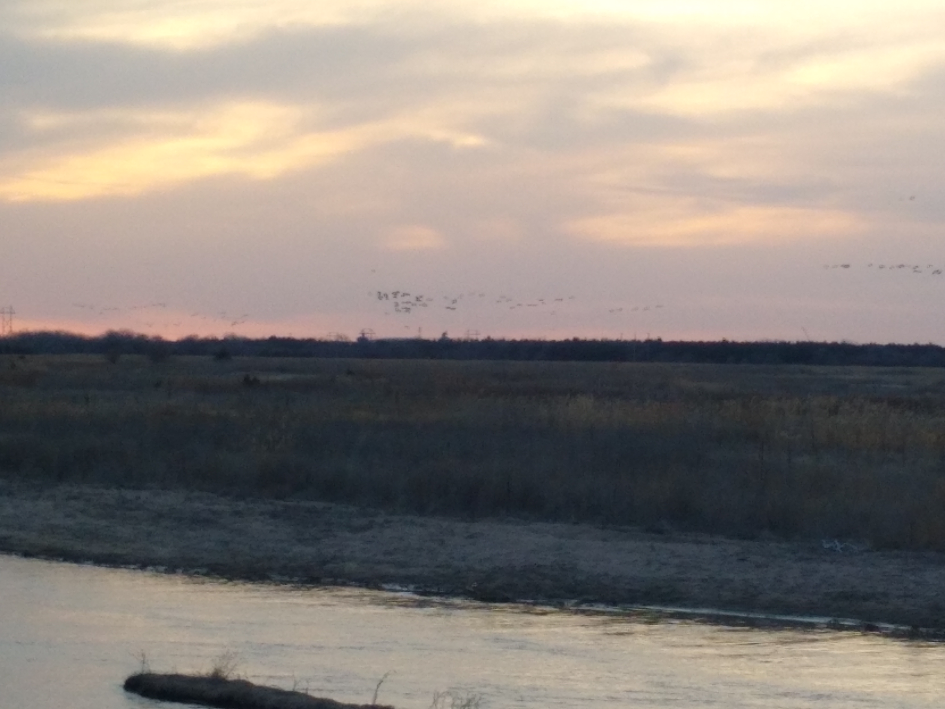
Phenology—the study of the timing of periodically recurring (usually seasonal) natural events.
Examples—migration, blooming, insect emergence, leaf color change
What does phenology have to do with climate change?
Could invasion be related to climate change and phenology? How?

Slide 3
Syllabus stuff
People intro
Name tags
Lots to do—keep up!
Communicate problems early
"Open your book" quizzes and other pre-lab assignments

Slide 4
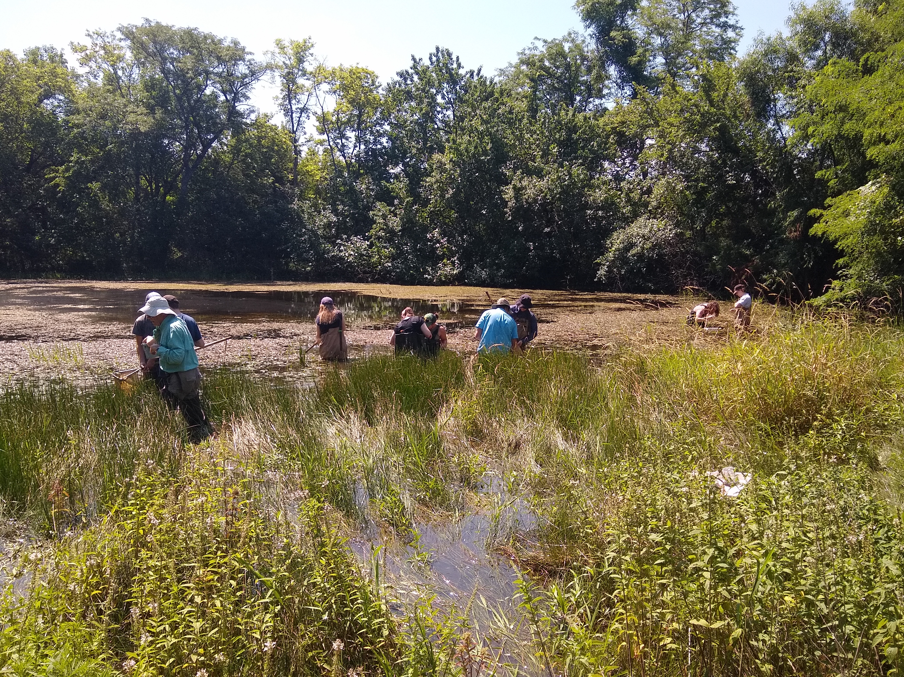
Prepare for outside
On time
Water and snack
Appropriate clothing
Sunscreen bug spray
Notebook and pencil
Our phone numbers

Slide 5
Ecology in Action (EIA)
Way to earn points by doing ecology outside of class.
Way to prevent a missed lab from becoming a zero.
Only way to earn "extra credit" (e.g. no personal last ditch assignments).
Add opportunities if you hear of them!
Start soon!

Slide 6
Phenology data--
Why fun and easy
Why frustrating and difficult

Slide 7
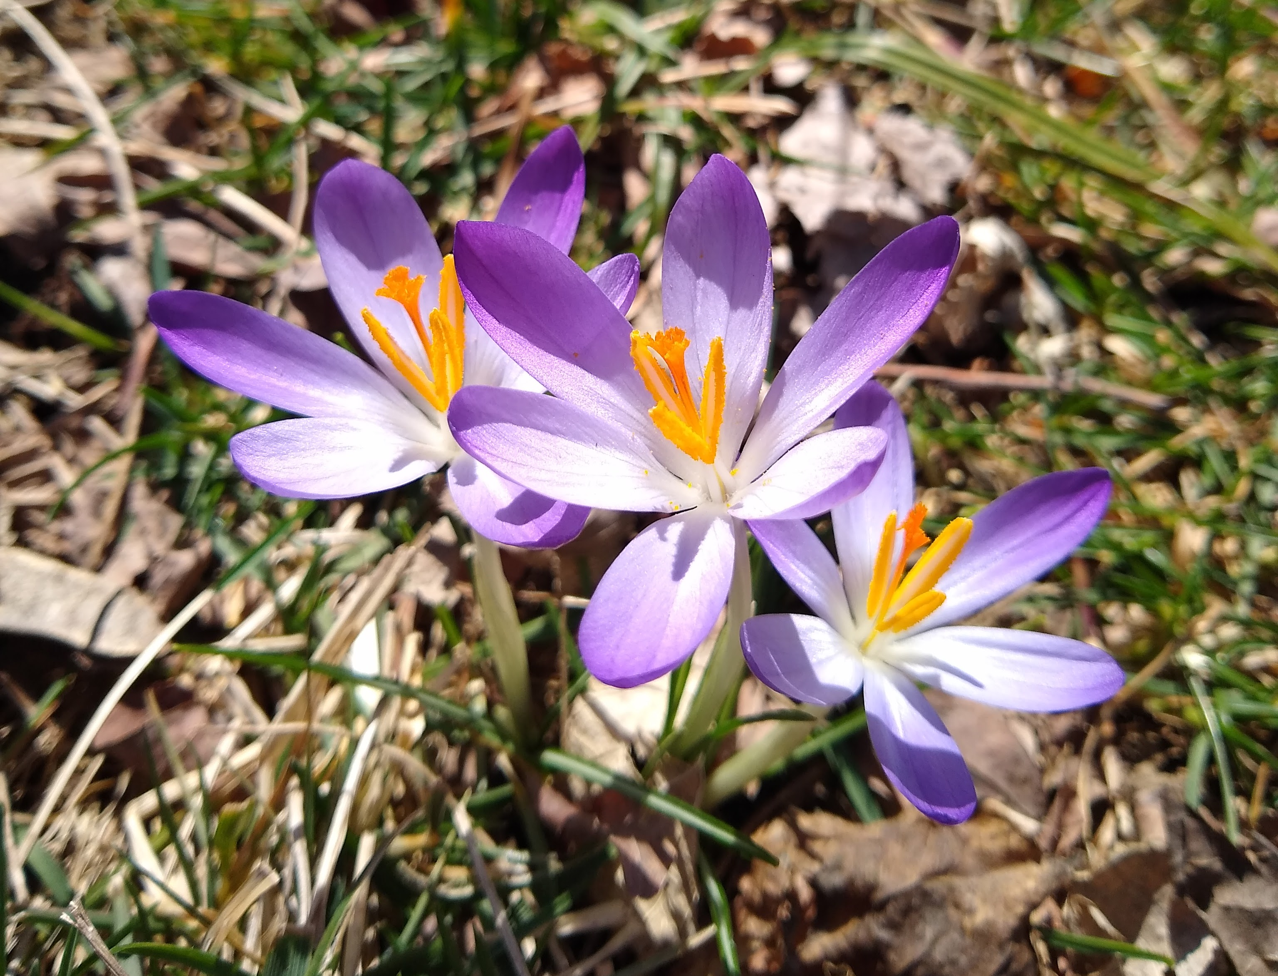
Sources of Information
Your observations!
(this was Feb. 25 in my yard in Lawrence)
You will be tracking two deciduous woody plants all semester

Slide 8
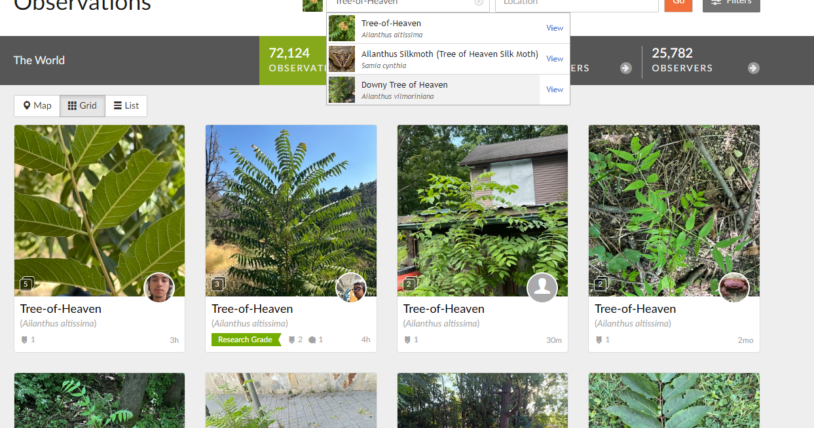
Sources of Information
Your observations!
Photos from web
https://www.inaturalist.org/observations?place_id=any&taxon_id=57278

Slide 9
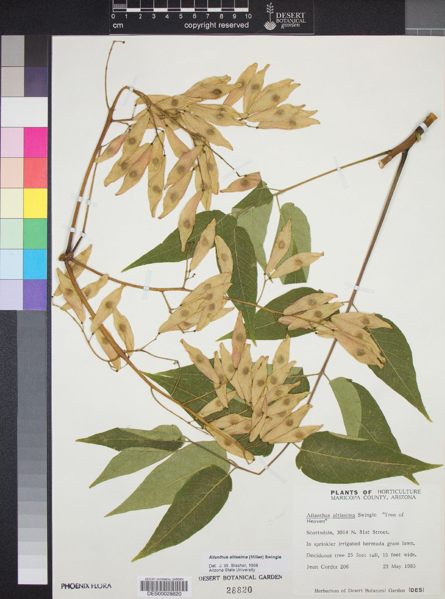
Sources of Information
Your observations!
Photos from web
Herbarium specimens
https://swbiodiversity.org/seinet/taxa/index.php?taxon=Ailanthus+altissima&formsubmit=Search+Terms

Slide 10
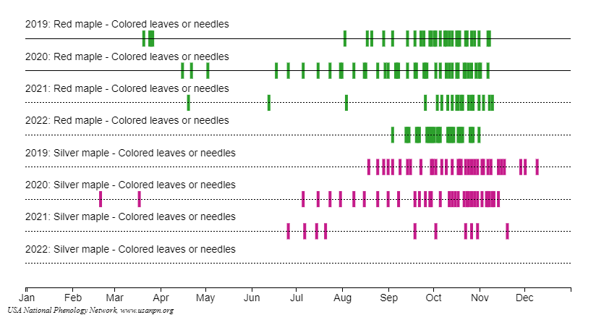
Sources of Information
Your observations!
Photos from web
Herbarium specimens
Nature's Notebook and the National Phenology Network
https://www.usanpn.org/data/visualizations

Slide 11
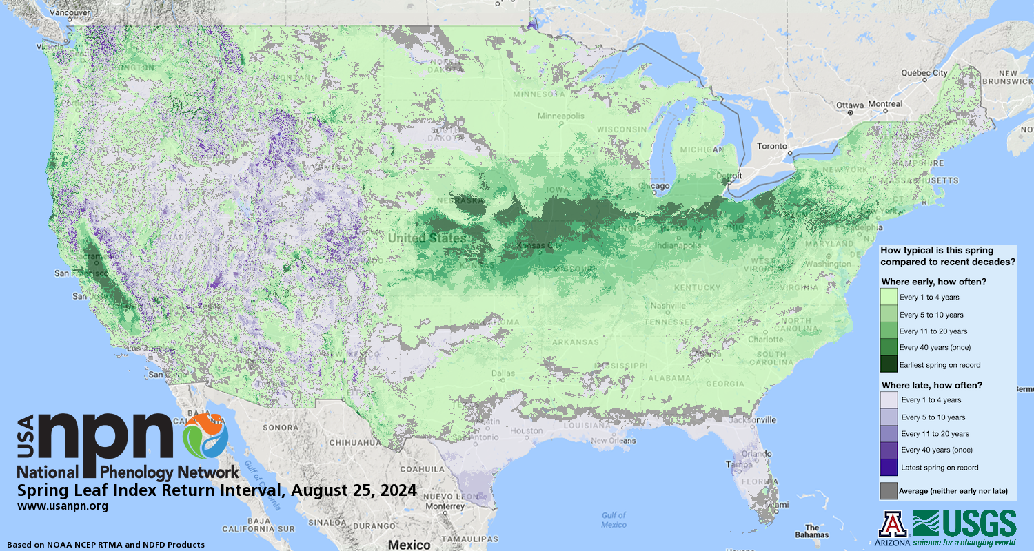

Slide 12
Your homework for NEXT week will be to test websites, make a calendar visualization in Nature's Notebook, and compare sources of phenology information.
Your homework before THIS WEEK's lab is to introduce yourself and to complete the Feinsinger reading.
All of the components (and, we admit, there are lots) are on Canvas.
Meet for lab in Malott 3048.

Slide 13
https://www.usanpn.org/data/visualizations

Slide 14
https://data.usanpn.org/vis-tool/#/explore-phenological-findings;s=eJztVU1v3DYQ%2FSsLNocW0Ar8lMi9BQkM9FA0iHszjAUlztqCKVKlJCeusf%2B9Q%2B2XNwF6KBCgh14EDefxzZvhE%2FVK4OsEKVhPNq%2FkXevtOJIN%2BWA9BGfTLXhopy4GUpCHuXOYAkm5q4VZu4bKtWwbWBtTubXQzjRcUyqqCtE9TBYp9wUJMH2J6elXh8R39wUZJ5sZz3GAB1x4BrLZWT%2FCZeFD9DFhxZ%2Bstcj4AjblLZwyU3DKaX6w%2FODIMvg45ewrGQdoOxg%2F2%2FCEm48R7j%2B9YZ9t7PsYtsH2WJUkcKveDh5ykxDmPID3LaRTuL2G%2F5ah4%2BrnDPnljMmzETV%2FU4akuUlzf6l8wBRkZ%2FvOvxwibs7xkf7WDh2OvgWb9Rxz1wpuox0aSOlldbOkEbcc3ELJ1Ck6630I0XdxGDtnz9Brxhsfv0DqwsPqk7dhyuOKyUFaGE19iq4lerjgvhE497YtVp9nWNngVt%2FoPRxHN3XjdrJfY4h9127HQDZc11xjz3NYPGf9dnoZMt9HnJ%2Bb4zyumhSt82B3yPCEel3sMb%2BIXuYV5h4rbWMzQnpefIYnwbSqGDpxeIQQh0c7wtEcB7u%2FTWR3LNH2MlFZXC0de1zcic5BMc9oh5hWAcAdZvIWPsKfM4QWt0iKGtqTqXlrKW%2FJvvgXjh07%2Fwzph5h2tG37aNEK3zm31ux%2F7%2F6Td1X9A7yrGeP%2FNeu2ijXakj1eu9424H%2Ff7UaYlmoNzuyTdQ7bIxta4nnuYphuu7%2FgI%2Fj8R6CIiXP%2Btyx%2Bw%2Fva2bx%2BdydMSXnNpaZK81pKVayNKhWtakYNF4JVQtwXd6IqBTVKsUqLSkkmMq4qFWe64lKJ2nDDM06XRkkqKBeaU1PrYs0oKqqkFozTM04KxFWcsVqo2gjFkA63ogRjzIVO8pIaLEyp4twgpSzWWpYUBRhRX%2BhQHuWqFjprRgaDdLTkmlX4b6z1GxjqqoysKsq4YlouXdRaKSEFP%2BLu9%2Fc4d5zthPNc7oGr98PH%2BUc3ebiJqbdT9sVi5vVy0vv9%2Fm9Ou40w

